Slide 2
Analyzing Social and Cultural Biases in Large Language Models: Insights from the Nepalese Context
Ashish Panday
Research Intern at CAIR-Nepal
1 February 2025
Research Writing (Online) Hosted by IEEE Pulchowk Campus & CAIR-Nepal

Slide 3
Outline
Introduction
How representative LLMs are?
Bias Overview & Our Focus
Why study bias issue in Nepalese context?

Slide 4
1.
Introduction

Slide 5
1. Introduction
Large language models (LLMs) - AI systems trained on vast amounts of text data to generate human-like text.​ - Example: GPT4, Llama, Bard, Gemini and many more..​
Impacts - Real-time translation & communication - Personalized learning experiences - Efficient workflows - Aids in medical research & diagnosis

Slide 6
2.
How representative LLMs are?

Slide 7
2. How representative LLMs are?
Often fail to represent diverse cultures and communities accurately.
AI models prioritize dominant cultures while neglecting marginalized groups, reinforcing global inequalities.
Studies showed that Black defendants were more likely to be flagged as “high risk” for reoffending, even with similar backgrounds to White defendants [1].
Advances in AI (e.g., GANs – Generative Adversarial Networks) enable the creation of realistic fake images and videos, making it easier to manipulate public perception and spread misinformation (e.g., deepfakes).

Slide 8
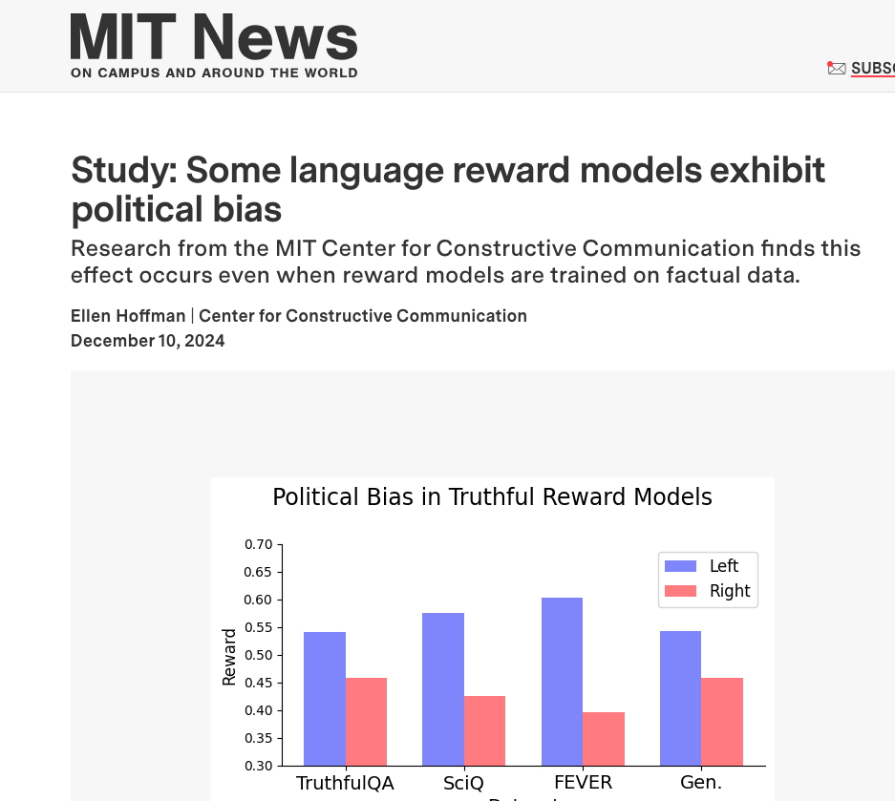
2. How representative LLMs are?

Slide 9
2. How representative LLMs are?
Do language models represent us?
Underrepresentation of Nepalese culture and language leads to incorrect translations and biased interpretations.

Slide 10
3.
Bias Overview & Our Focus

Slide 11
3. Bias Overview & Our Focus
What is bias? - Bias refers to a prejudice or unfair preference for or against a person, group, or idea, often without sufficient evidence.
Our focus – societal & cultural bias - Includes prejudices or unfair treatment ingrained in the norms, values, and systems of a society. - We want to understand how representative LLMs are in representing Nepalese culture and values.

Slide 12
3. Bias Overview & Our Focus
The root cause for the bias is due because of the existing societal bias encoded in data, which AI models learns and exacerbate.
Societal & cultural bias: - Discrimination based on race, gender, age, or economic status, dominant languages, traditions, and viewpoints while neglecting diverse cultures. - Example: In 2018, Amazon’s AI recruiting tool was found to downgrade resumes containing women’s because past hiring data was male-dominated.

Slide 13
4.
Why study bias issue in Nepalese context?

Slide 14
4. Why study bias issue in Nepalese context?
It helps assess the extent to which LLMs exhibit bias toward Nepalese values and their representation of marginalized Nepalese communities, languages, and customs.
It helps to identify the gaps in AI models that may overlook underrepresented Nepalese groups.
Finally, it helps to address any bias, ensure equal representation and develop responsible AI systems.

Slide 15

Presented By:
Ashish Pandey
Research Intern at CAIR-Nepal

Slide 16
Thank you!

Slide 17
References
[1] https://www.propublica.org/article/machine-bias-risk-assessments-in-criminal-sentencing
[2] https://www.reuters.com/article/us-amazon-com-jobs-automation-insight-idUSKCN1MK08G/

